Slide 1
Introduction to LLM
Hailiang Chen
HKU Business School

Slide 2
Course Information
Instructor:
Prof. Hailiang CHEN, chen19@hku.hk
Consultation Hours:
Time: TBD
Office: Room 840, KK Leung Building, Main Campus
Teaching Assistant:
Miss Ruoxin Li, ruoxinli0112@connect.hku.hk: assignment grading
Mr. Shuang Li, ls499858@hku.hk: attendance

Slide 3
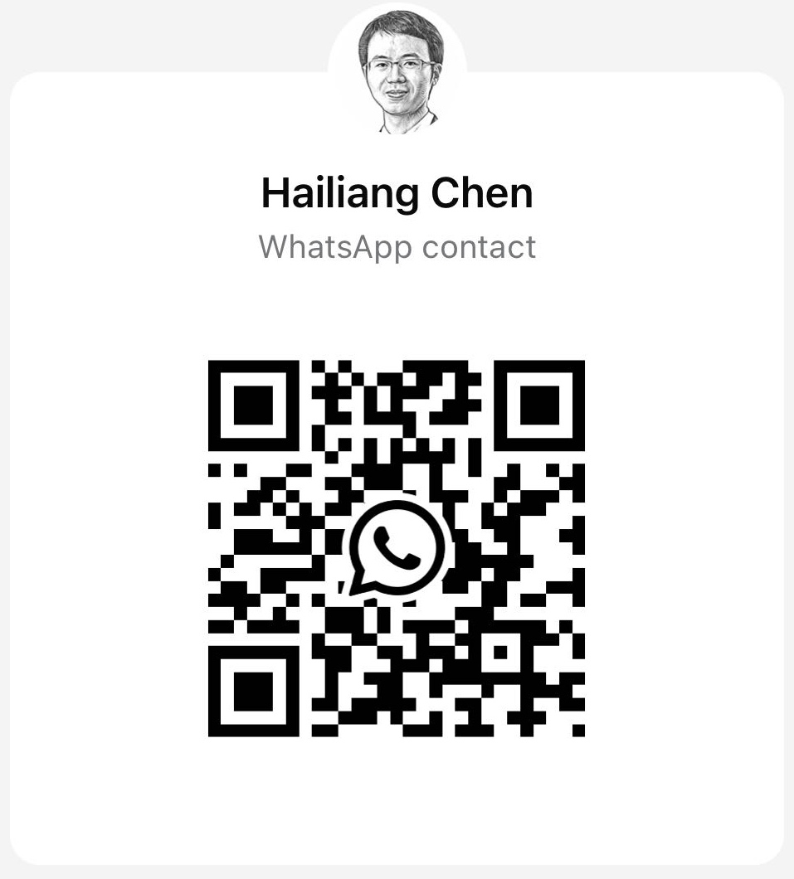
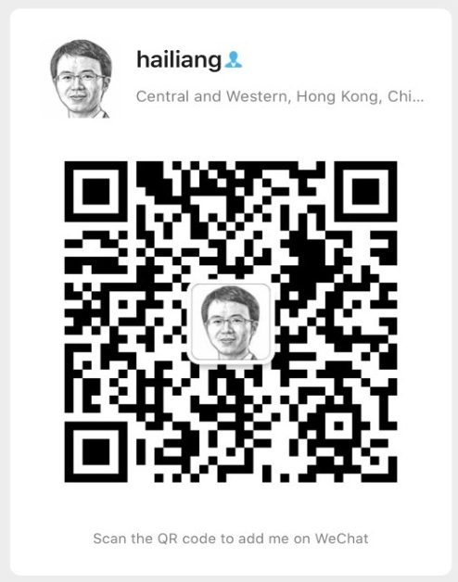
Contact Me
WhatsApp
WeChat
Email: chen19@hku.hk
Mobile/WhatsApp: 56338553
WeChat: better4us
LinkedIn: https://www.linkedin.com/in/hailiang-chen/

Slide 4
Course Information
Assessment
In-class and Online Participation: 20%
Individual Assignment: 30%
Group Project: 50%
Attendance follows faculty policy; students must attend at least 70% of lectures to pass.
Group Project assessment is also individual-based, i.e., different members in the same group can get very different scores.

Slide 5
Utilisation of AI Tools
The use of AI tools is permitted and highly recommended.
Nevertheless, any use of AI must be documented for both individual assignments and group project submissions.
Adhere to the provided guidelines to properly disclose AI involvement.

Slide 6
Course Information
Participation: 20%
In-class Participation: 10%
Attending more lectures would be appreciated
In-class Participation Self-Report Google Form: https://forms.gle/nwhNfZ8PosZZYwBB9
Ask/answer questions; make comments; make presentations
Online participation through Moodle and other designated platforms: 10%
Take-home assignments on Moodle
In-class presentation submissions on Moodle
Course forum
“Novel” contribution to discussions: no duplicate content
Asking for help or offering help on technical issues

Slide 7
In-class Individual Presentation
Share anything interesting or useful about LLM
Upload presentation slides (.ppt or .pptx) on Moodle (submissions accepted continuously; earlier submissions are encouraged)
Earn credits for online participation
Qualify for the limited opportunity to present
Presenters for upcoming lectures will be informed several days in advance
Presentations are limited to a maximum of 5 minutes each
Presentations typically begin after the first break

Slide 8
Sample Ideas for Individual Presentations
Present solutions for a take-home ungraded assignment
Recent advancements in large language models and AI agents
Personal approach to applying LLMs for a particular challenge
Innovative ways to utilise LLMs
Constraints and challenges of LLMs
Practical implementations of LLMs in real life
…

Slide 9
Course Information
Individual Assignments: 30%
AI Resume Editor
Function Calling for GitHub Repository Queries
You should complete the assignments by yourself without consulting other students or the TA, i.e., treat it like a take-home and open-book exam

Slide 10
Course Information
Group Project: 50%
Project Proposal (one page): 5%
Data and Program Code: 15%
Project Report (10 pages max): 10%
Group Presentation: 20%
Each group member is encouraged to present
8 members/group
Randomly assigned presentation sequence

Slide 11
Group Project
Group formation on Moodle (Mar 27 Friday)
Find team members by yourselves first if you want
On Mar 28, those who do not find a group by the deadline will be randomly assigned to groups that are not full
Factors to consider
Each team should have an agreement on how to work together
Instead of having one fixed team leader, members can take turns to be the leader

Slide 12
Group Project Ideas
AI-generated Financial Analyst Reports
Competitive Intelligence for Master Programs
Agent‑Based Intelligent Travel Planner

Slide 13
1. AI-generated Financial Analyst Reports
Develop a system to generate high-quality analyst reports for stocks to support investment decision-making
Focus on HK or US stocks
Potential data sources
Financial statement and market data from WRDS through the university library
Yahoo Finance
Seeking Alpha
Firm filings

Slide 14
2. Competitive Intelligence for Master Programs
Develop a system to collect, structure, and analyze public data on business school master programs to support strategic decisions by deans and program directors
Focus on non-MBA master programs (i.e., TPG programs)
Use publicly available information only (program websites, brochures, rankings, news, etc.).

Slide 15
3. Agent‑Based Intelligent Travel Planner
Develop an AI agent that creates personalized travel plans for individuals or groups by integrating maps, POI data, and social media content to support travel decision‑making
Focus on trip planning for a city or region (e.g., 2–5 day itinerary)
Use free or public data sources (e.g., Gaode Maps API, RedNote).
Travel scenarios may include leisure, family, or theme‑based trips.

Slide 16
Group Project Proposal
Due on April 9 (Thursday)
One page only
Outline
Summarize your project idea in one paragraph first
Clearly define the problem
Provide an outline of your AI solution to the target problem
Describe any data required in your solution
Identify the key challenges of your project
Describe how to allocate work across your group members
Do not simply say everyone will do every task equally

Slide 17
Group Project Report
Due on May 3 (Sunday)
10 pages max
Outline (for your reference only)
Introduction (2 pages max; an executive summary of your project)
Project idea
Key components of your solution
Main findings or deliverables
Methodology (3 to 4 pages)
A detailed summary of your solution to the target business problem
Identify the key challenges and how you address them
Results (2 to 3 pages)
Limitations and Future Work (1 page)
Work Allocation (1 page)
Describe how work tasks are distributed across your group members

Slide 18
Purposes of Each Assessment
Participation
You can share your views and opinions with others in a business setting.
You can conduct research on your own and summarize what you have learnt.
You can provide technical support and help to others, e.g., colleagues, clients, etc.
Individual Assignment
Apply LLMs to solve problems independently with AI assistance.
Group Project
Acquire practical experience in applying LLM knowledge in a team environment.
Develop soft skills such as project management, communication/presentation, teamwork, leadership, and so on.

Slide 19
Topics
Introduction to Large Language Models (LLMs)
Prompt Engineering
Building a Chatbot
Context Management
From Command-line to Web Chatbot
Function Calling

Slide 20
Topics
Retrieval-Augmented Generation (RAG)
Embedding
Vector Search
Vector Database
Reranking
Agents
Microsoft Foundry
Fine-Tuning LLMs
Vibe Coding

